Slide 1
CS 385 Computer Architecture: Pipelined 16- bit MIPS CPU
Chris Mazurski
Thomas Klejmont
Uka Chukwuogor

Slide 2
Instruction Set
Instruction | Opcode | Type
add | 0000 | R-type
sub | 0001 | R-type
and | 0010 | R-type
or | 0011 | R-type
addi | 0100 | I-type
lw | 0101 | I-type
sw | 0110 | I-type
slt | 0111 | R-type
beq | 1000 | I-type
bne | 1001 | I-type

Slide 3
Instruction Types
R-Type: Register instructions. For our implementation these consist of a 4 bit opcode, and three register operands that hold 2 bits each. (ex. op rs rt rd)
I-Type: Immediate instructions. Instead of a two source registers and a destination, these contain a destination, a source, and an 8 bit immediate value given by the instruction itself. (Ex. op rt rs immed)
Branch: I-type instructions that use the immediate value to add to the program counter and jump to a part of memory if conditions are met.
Data Transfer: I-type instructions that use the immediate value as an offset to determine a location in memory. Used for load and store instructions.

Slide 4
Pipelining vs. Single Cycle
Single cycle data path only handles one instruction at a time.
A 5-stage pipeline is able to handle several instructions concurrently, which is considerably faster.
Pipelined datapaths need to be wary of hazards (such as dependencies while multiple instructions run in parallel).

Slide 5
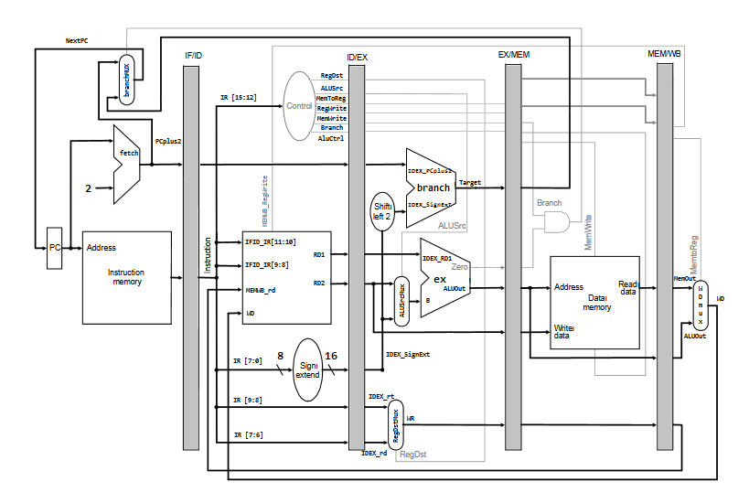
Overview: Pipeline Datapath

Slide 6
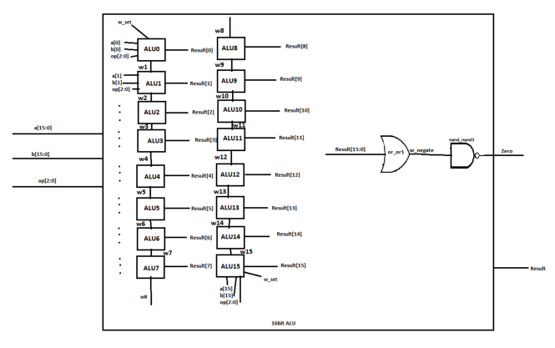
Overview: Arithmetic Logic Unit (ALU)
A combinational circuit built from smaller 1-bit ALU’s to provide 16 bit functionality.
Performs calculations on given operands.

Slide 7
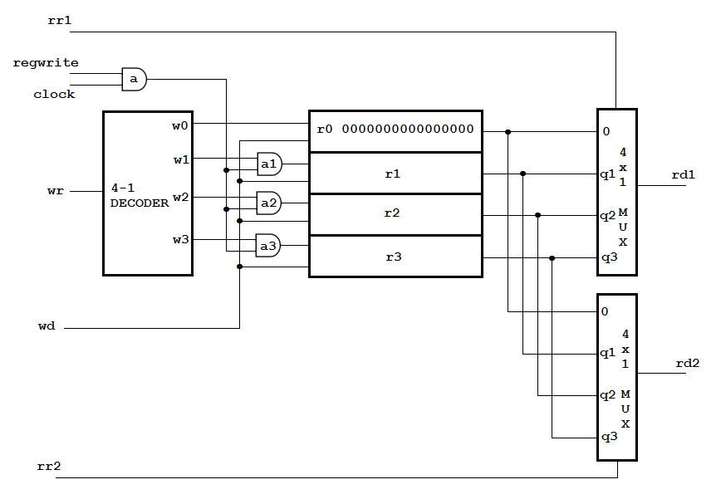
Overview: Register File
A combinational circuit built from decoders and multiplexors.
Used to read and write data.

Slide 8
Stepping Through
Assume the next assembly instruction coming in is: add $1,$3,$2
Instruction Fetch: Read in an instruction from a memory address provided by incrementing the program counter (PC).
Instruction Decode: Locate operands from the register file (In this case destination register $1 and the source registers $3 and $2). Additionally, the control bits are calculated from the addition instruction opcode and passed to the rest of the steps in order to perform the correct calculations.
Instruction Execute: The ALU takes in the operands and performs calculations based on the control bits that are propagated. For addition, the ALU needs the bits 010 as input.

Slide 9
Stepping Through
Memory Access: Manipulate the data memory, necessary for load and store operations, as well as for figuring out the address to branch to. For our example this phase will do nothing.
Write Back: Write results to register. In this case, the result of $3+$2 will be placed into $1

Slide 10
Sample Code
lw $1, 0($0) //Takes the value in memory address $0+0 (Data Memory[0]) and stores it into $1
lw $2, 2($0) //Takes the value in memory address $0+2 (DataMemory[1]) and stores it into $2
slt $3, $2, $1 //Will store 1 in $3 if the value in $2 is less than the value in $1, otherwise stores 0
bne $3, $0, 2 //Takes the immediate value 2, left shifts it by 2, and adds it to the program counter if $3 is not equal to $0
sw $1, 2($0) //Takes the value in $1 and stores it into data memory located in $0+2
sw $2, 0($0) //Takes the value in $2 and stores it into data memory located in $0+0
lw $1, 0($0) //Takes the value in memory address $0+0 (Data Memory [0]) and stores it into $1
lw $2, 2($0) //Takes the value in memory address $0+2 (Data Memory[1]) and stores it into $2
sub $1, $1, $2 //Subtracts the value in $1 with $2, and stores into $1
addi $1,$1,6 //Adds the immediate value 6 to register $1 and stores it into $1

Slide 11
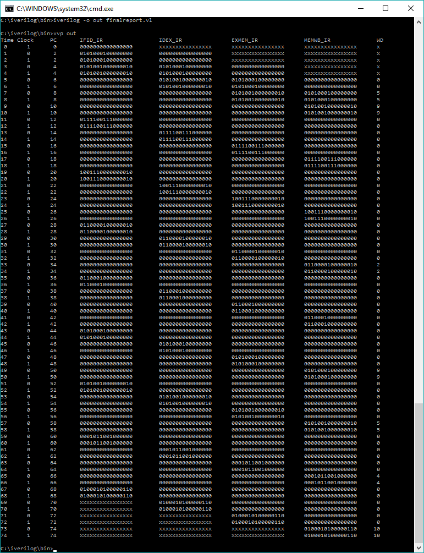
Sample Code Output

Slide 12
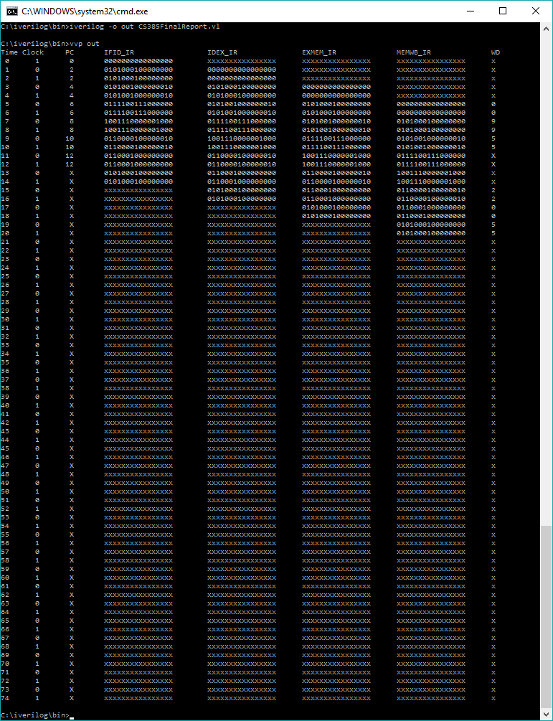
Sample Code Output (Hazards)

Slide 13
Conclusion
Pipelining provides a quicker way to complete instructions, assuming there exists a form of hazard mitigation.
For our implementation, stalling via No-Op instructions would avoid undesired behavior.

